Slide 1
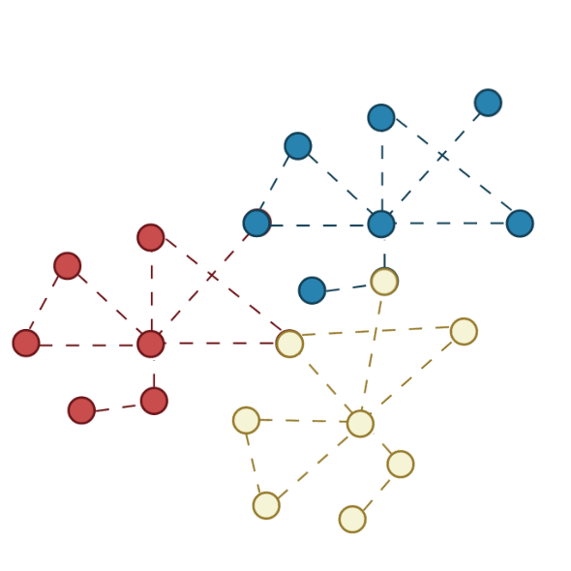
Gene Set Enrichment Analysis
Saudat Alishayeva

Slide 2


Slide 5
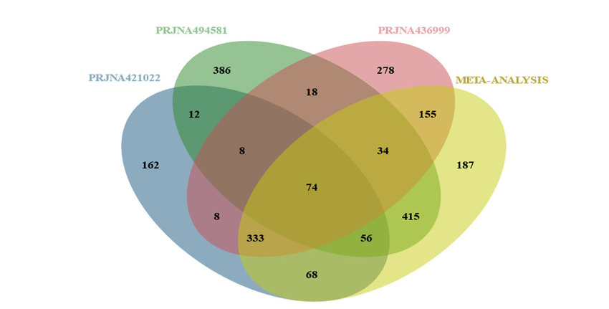
Do differentially expressed genes overlap with different experiments?
Kanakoglou et al, 2020

Slide 6
Do differentially expressed genes overlap with different experiments?
P value
P value
P value
P value
P value
P value
P value
P value
P value
P value
P value
P value
P value
Kanakoglou et al, 2020

Slide 7
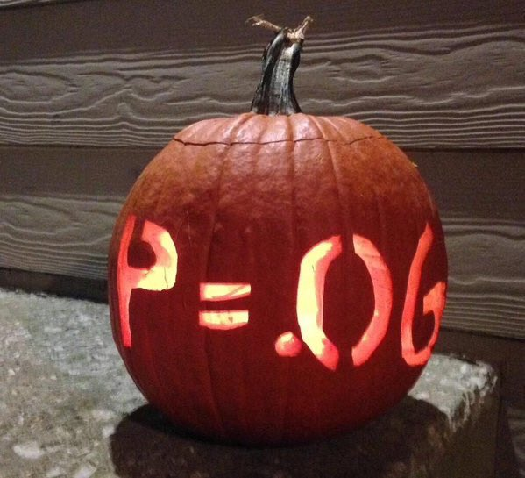
Statistical significance or biological relevance?

Slide 8
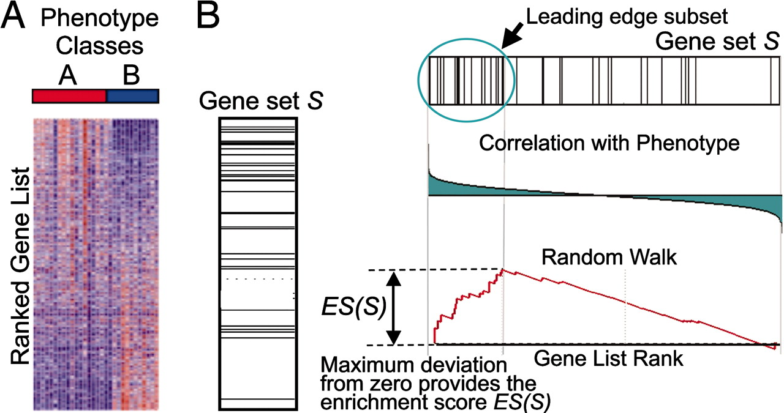
Illustration of GSEA method
Subramanian et al. PNAS 2005

Slide 9
Illustration of GSEA method
P < 0.05
Subramanian et al. PNAS 2005

Slide 10
Illustration of GSEA method
Subramanian et al. PNAS 2005

Slide 11
Illustration of GSEA method
Subramanian et al. PNAS 2005

Slide 12
Illustration of GSEA method
Subramanian et al. PNAS 2005

Slide 13
Illustration of GSEA method
Subramanian et al. PNAS 2005

Slide 14
Illustration of GSEA method
Subramanian et al. PNAS 2005

Slide 15
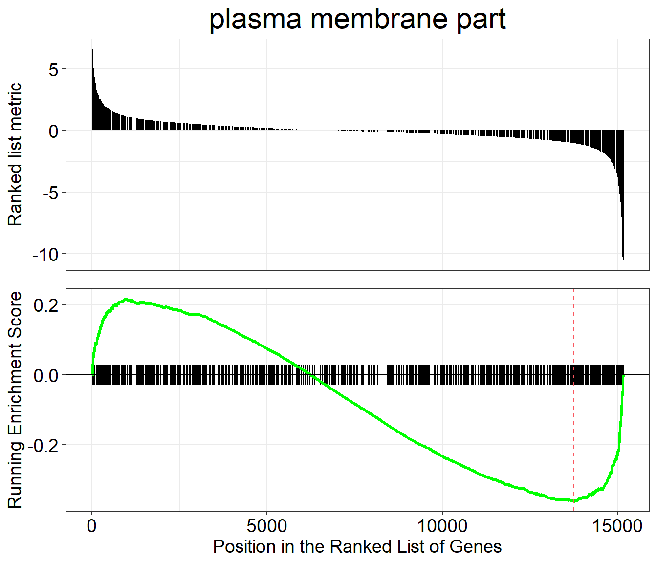
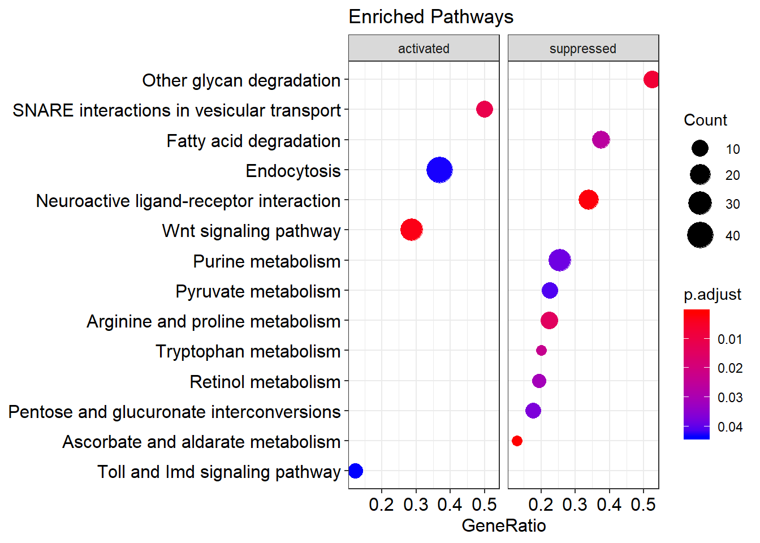
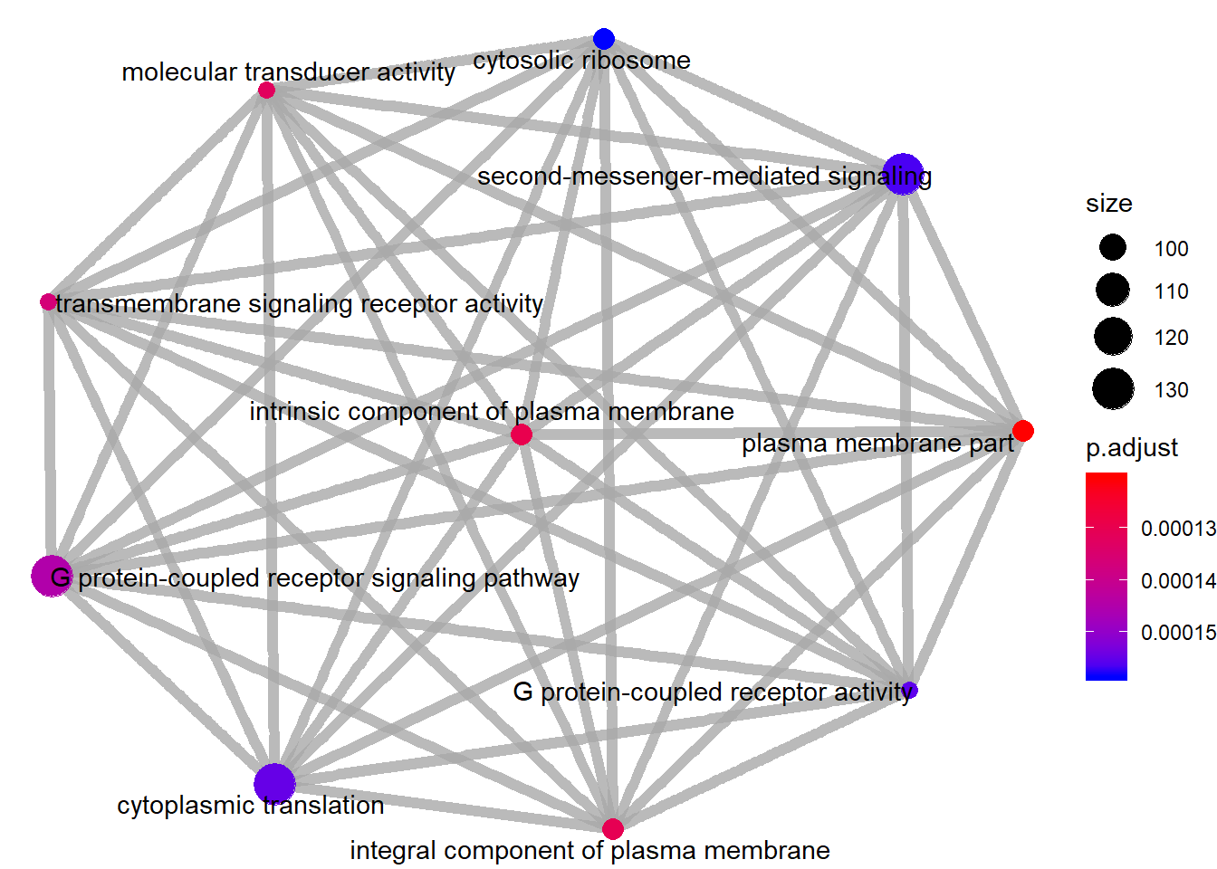
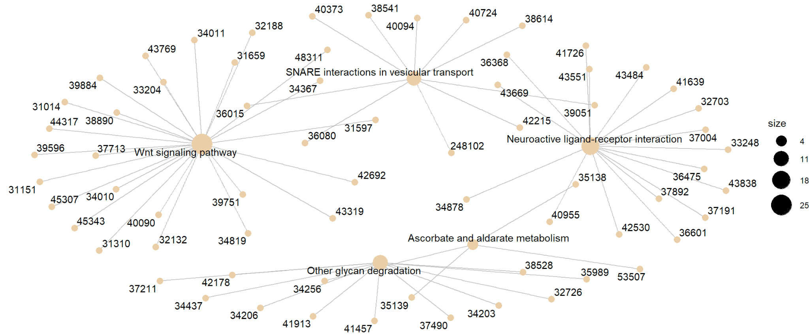
Four Horsemen of GSEA data visualization!
Standart GSEA Dotplot pathways Enrichment Map Category Netplot
Notes:
Dotplot:
Enrichment Map: organizes enriched terms into a network with edges connecting overlapping gene sets. In this way, mutually overlapping gene sets are tend to cluster together, making it easy to identify functional modules.
Category Netplot: depicts the linkages of genes and biological concepts (e.g. GO terms or KEGG pathways) as a network (helpful to see which genes are involved in enriched pathways and genes that may belong to multiple annotation categories).
Ridgeplot: Helpful to interpret up/down-regulated pathways
GSEA Plot: traditional
PubMed plot: publications per a functional pathway
Pathview

Slide 16
Four Horsemen of GSEA data visualization!
Standart GSEA Dotplot pathways Enrichment Map Category Netplot
Identify Up/Down regulated pathways
Functional modules of overlapping genes
linkages of genes and biological concepts

Slide 17
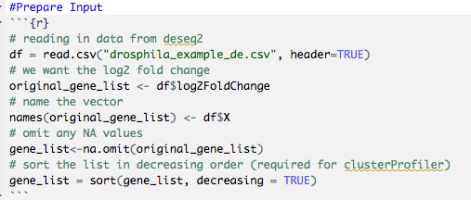
GSEA tutorial (in R)
Step 1 : Prepare a list of all genes that is ranked based on log2 fold change

Slide 18

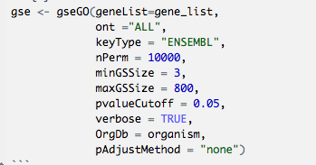
GSEA tutorial (in R)
Step 2 : Use gseGo() function to perform the analysis

Slide 19
GSEA tutorial (in R)
Step 2 : Use gseGo() function to perform the analysis

Slide 20
GSEA tutorial
Step 3: Generate standard GSEA plot

Slide 21
GSEA tutorial
Step 3: Generate standard GSEA plot

Slide 22
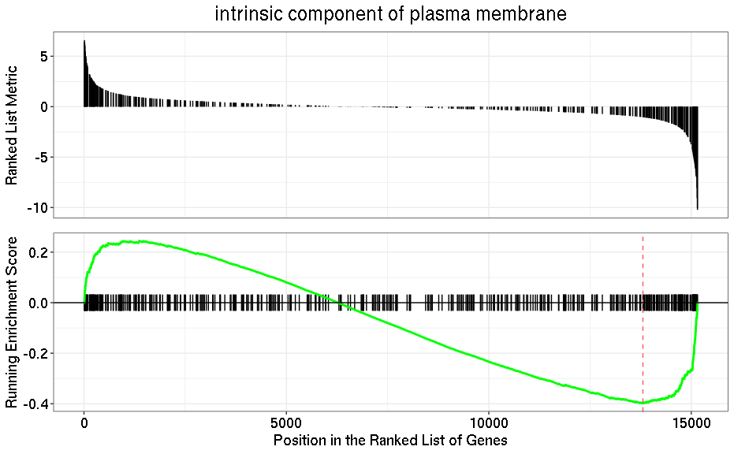
GSEA tutorial
Step 3: Generate standard GSEA plot

Slide 23
GSEA tutorial (in R)
Step 4: Prepare Dotplot

Slide 24
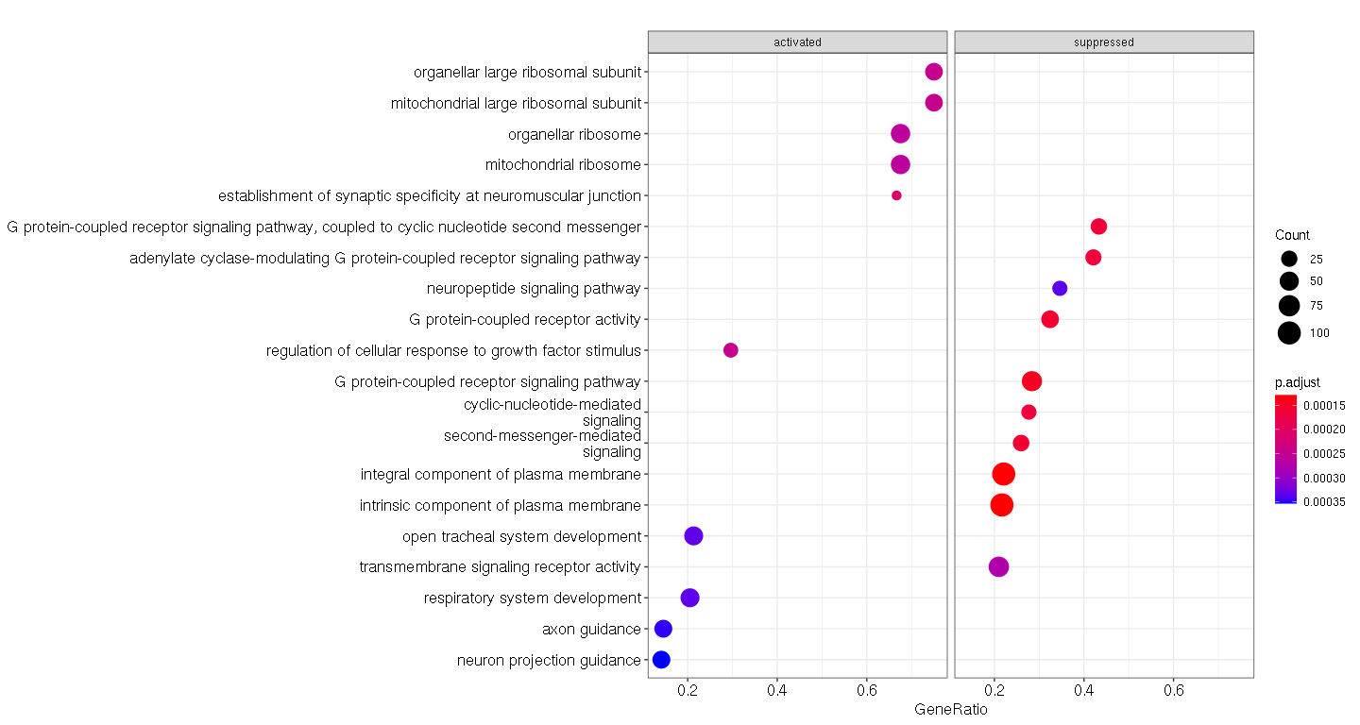
GSEA tutorial (in R)
Step 4: Prepare Dotplot

Slide 25
GSEA tutorial
Step 5 : Prepare CNetplot

Slide 26
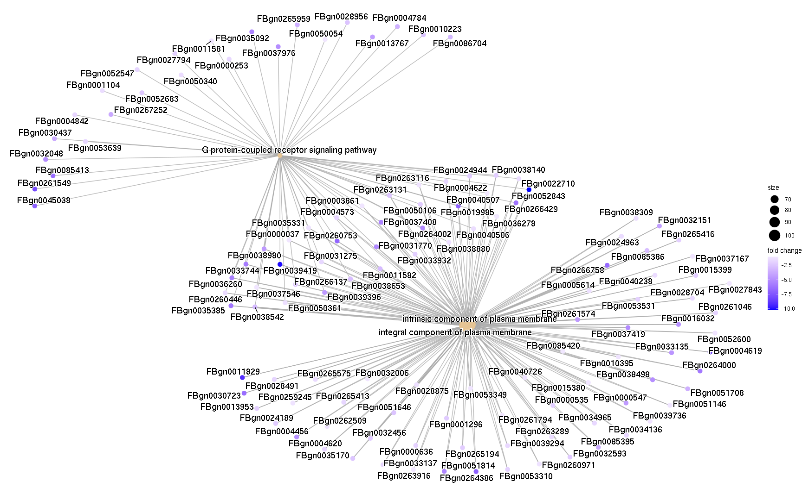
GSEA tutorial
Step 5 : Prepare CNetplot

Slide 27
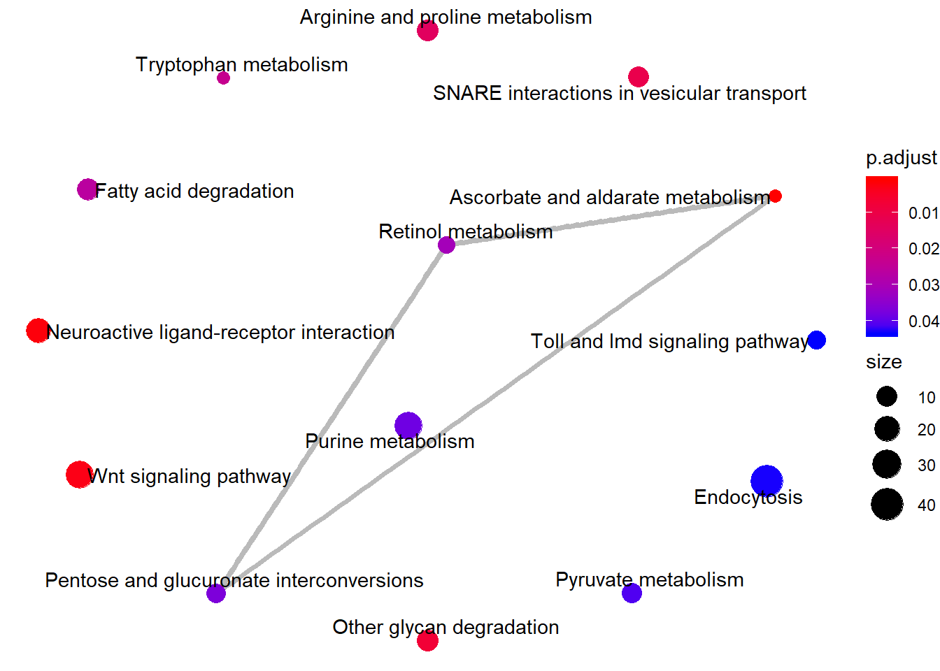
GSEA tutorial
Step 6: Prepare Enrichment Map

Slide 28
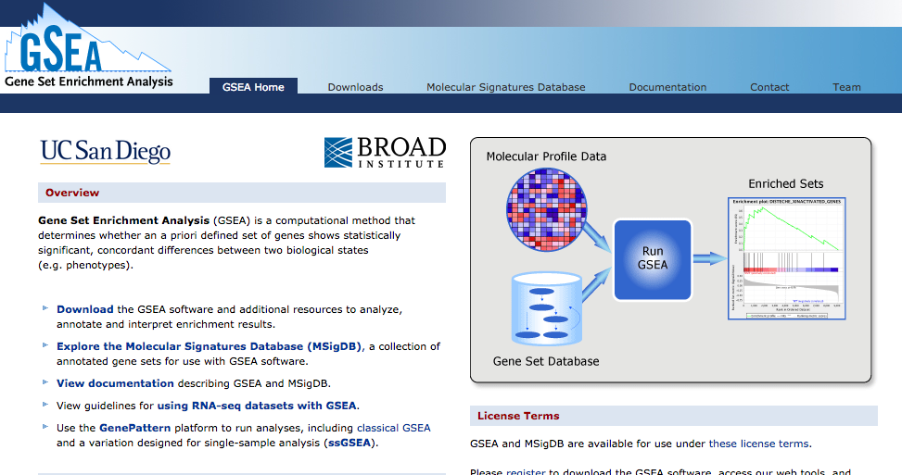
Which input?

Slide 29
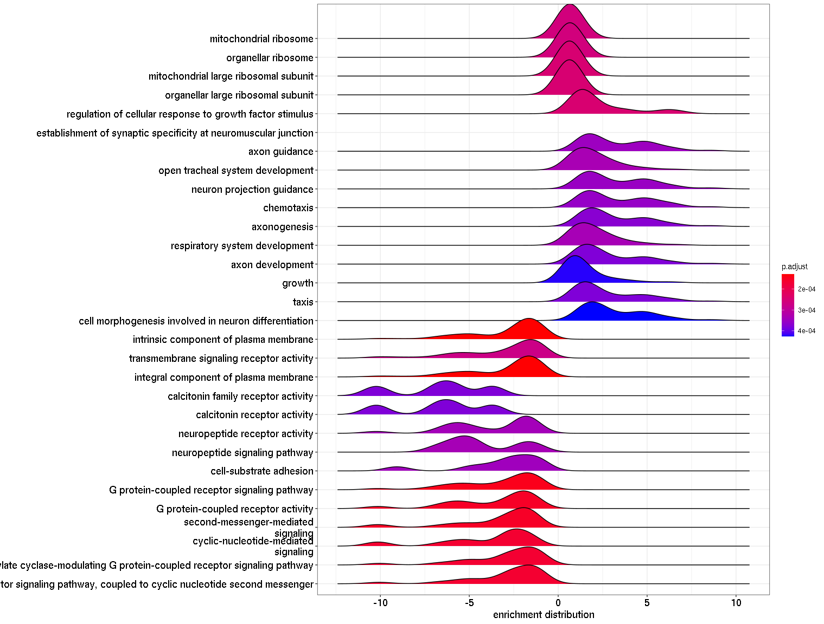
Additional Ways of Visualizing GSEA results
Ridge Plot

Slide 30
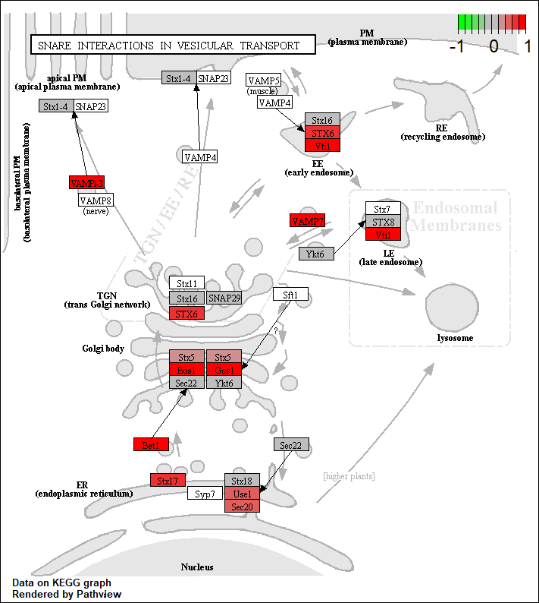
Additional Ways of Visualizing GSEA results
Pathway view plot

Slide 31
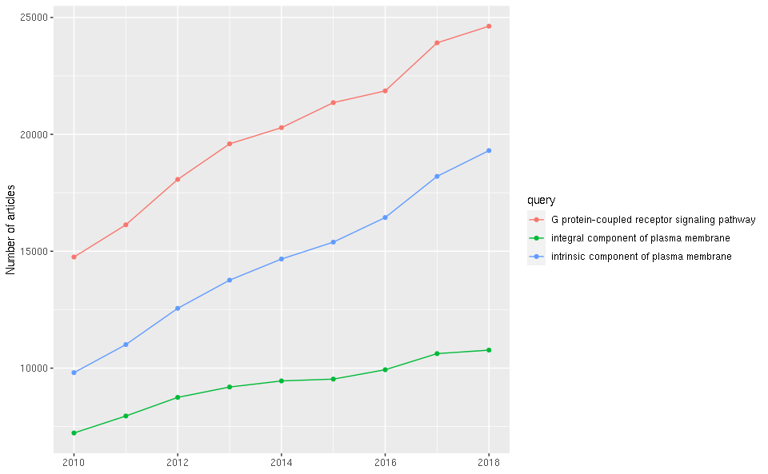
Additional Ways of Visualizing GSEA results
PubMed plot

Slide 32

User: saudat-bio-code
URL: https://github.com/saudat-bio-code/2021_LMU_GSEA_tutorial

Slide 33
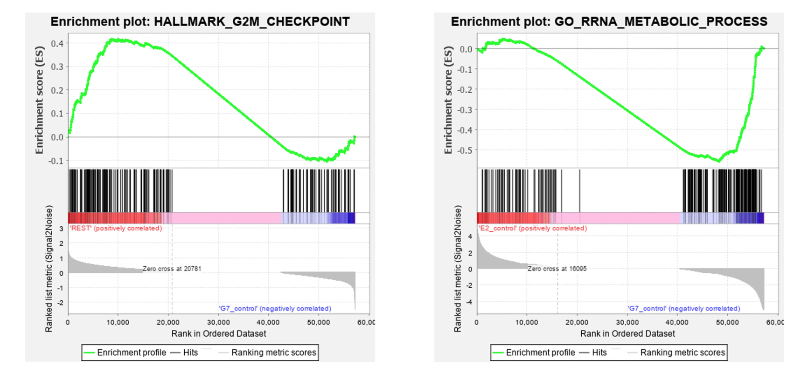
Supplementary slide: examples of GSEA plots

